Slide 1
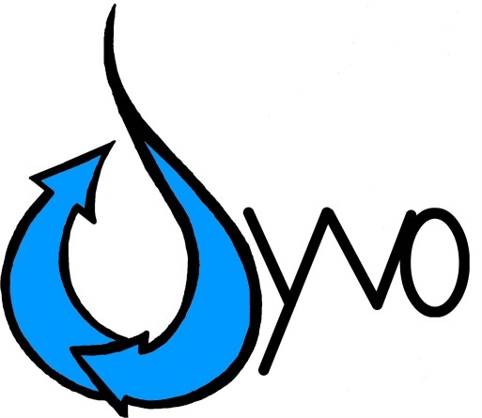
Water
Healthy Water, Healthy Life

Slide 2
Management Team
Armand- CEO and Research
Akhil - VP Business Development and Sales
Ricky – VP Design and Product Management
Sanath - VP of Marketing
Sreyas- CFO and COO

Slide 3
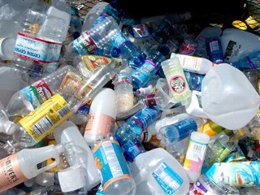
Problems?
Purified water not available anywhere, anytime.
Not having the right amount of minerals in our body.
Current water bottles don’t contain enough magnesium.
Filtered water is expensive.
Pitcher Filters do not eliminate all impurities.
50 billion plastic water bottles end up in U.S. landfills each year.
Notes:
Roughly 50 billion plastic water bottles end up in U.S. landfills each year — 140 million every day! That’s enough, laid end to end, to reach China and back each day.
The plastic which are used to make the containers contain chemicals are well. These chemicals are absorbed by the water when it comes in contact with the container. The chemicals in the plastic containers have also been proven to cause cancer.
Based on the poor quality of what comes out of the municipal tap, health-conscious people often rely on bottled or home-filtered water for their drinking needs. While most filtered and bottled waters are free of cancer-causing contaminants, they provide little or no magnesium. Even most tap water is devoid of this critical mineral.

Slide 4
Why Magnesium?
Over 70% of adults do not consume the recommended amount of Magnesium.
A census in 2oo9 determined that people consumed 175-225 mg vs. 400 mg needed.
Magnesium deficiency can lead to cardiovascular problems, muscle pain, fatigue, and insomnia
Source: http://www.ancient-minerals.com
Notes:
magnesium content of water is indeed a cardiovascular risk factor

Slide 5
Source: http://www.ancient-minerals.com

Slide 6
What does Ayvo do?
Filters out impurities from water.
Adds Magnesium to water.
Benefits:
maintains normal heartbeat
vital for bones and muscles
Decreases disposable water bottles that are going into landfills
Notes:
Ayvo filters out impurities from water such as: Asbestos, bacteria, microscopic worms, lead and other metals
Adds Magnesium to water making it healthier to drink
vital for bones and muscles because helps body absorb calcium, reduces high blood pressure and helps asthma
Decreases disposable water bottles that are going into landfills by using Ayvo Bottle as a substitute

Slide 7
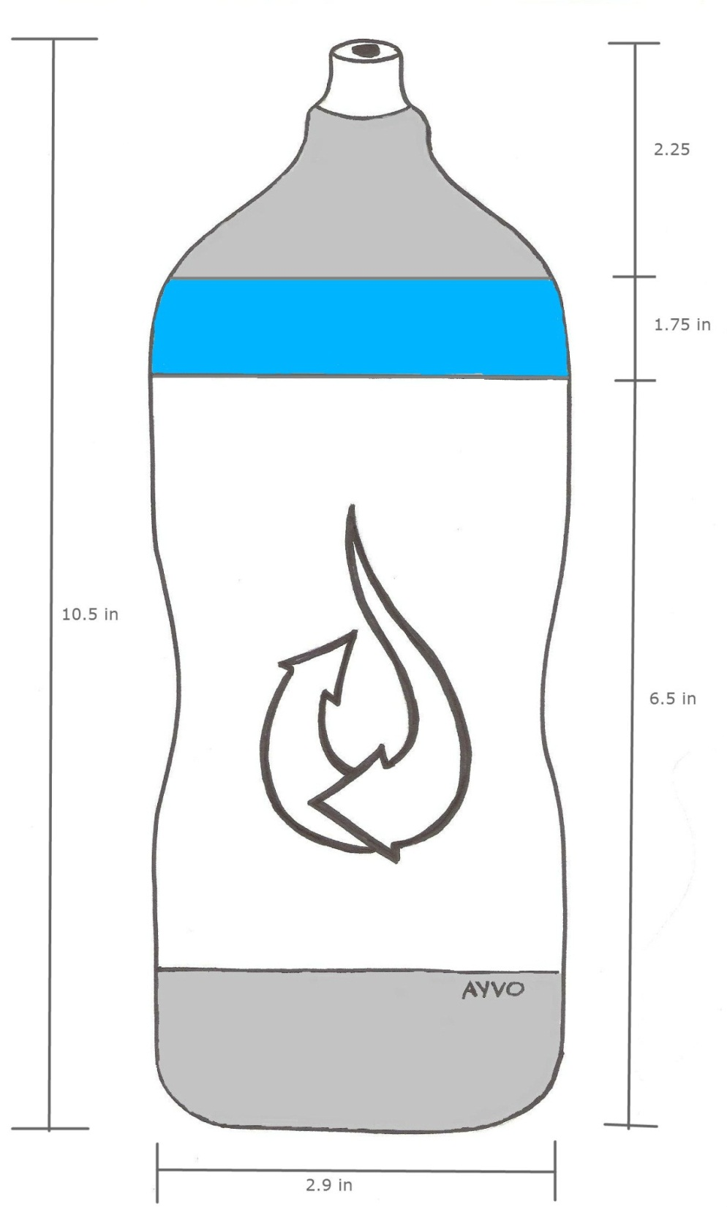

Slide 8
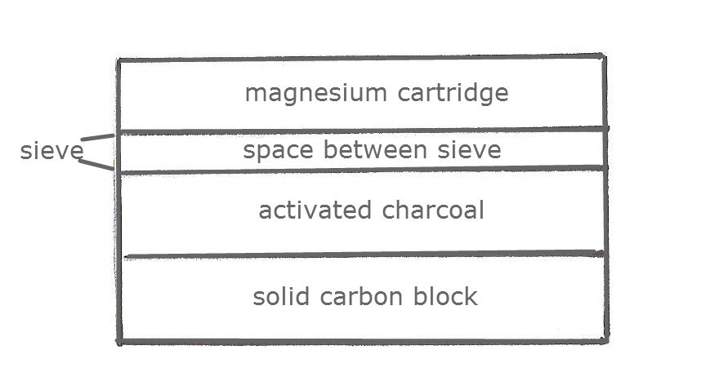
How?
a
Metals, lead, chlorine
Bacteria, asbestos, sediments

Slide 9
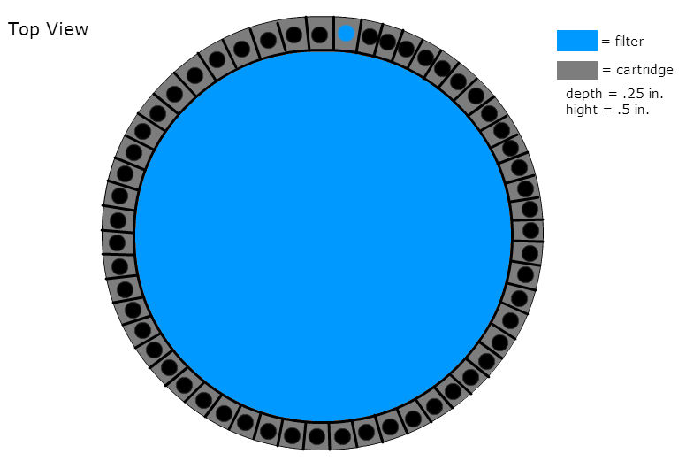

Slide 10
Market Data
2011, total bottle sales in America hit 9.1 billion gallons
222 bottles of water for each person
Water bottle sales are booming, purchases volume increased by 4.1 percent in 2011
28.9% of the U.S. liquid beverage market
About 25% of U.S. bottled water sold is purified municipal water

Slide 11
Geographics
American cities with the worst drinking water:
9. San Diego
8. North Las Vegas
7. Omaha
6. Houston
5. Reno
4. Riverside County, Calif.
3. Las Vegas
2. Riverside, Calif.
1. Pensacola, Fla.

Slide 12
Filter Competitors
Source: waterfiltercomparisons.com

Slide 13
Water Competitors
Source: business.library.wisc.edu

Slide 14
Go To Market Strategy
Initial Target partners and customers
Athletes, Vitamin Deficients’, and elderly
Gyms and health stores. The retailers we are targeting are GNC, Academy and several other retailers. Gyms such as Lifetime Fitness.
How do we reach these customers and partners?
Positioning - BEST IN CLASS
Healthy water available anywhere and anytime – BEST IN CLASS
Marketing and PR – GENERATE BUZZ
Website SEO/SEM
Tech sites/blogs
Industry magazines
Endorsements
Channels – THREE PRONGED APPROCH
Direct Sales
Partnership
Online Sales

Slide 15
E-Commerce vs Retailers
E-Commerce
Retail
Online can provide subscription model
Marketing through social media
Availability anywhere in the nation
Local small businesses
Staying exclusive
More stores will pick up Ayvo over time
Can be put on shelves nationwide

Slide 16
Manufacturing and Distribution
Manufacturing through reputable factories from alibaba.com
Acquisition in United States
Consumer purchase through e-commerce or retail
IF purchased through E-COMMERCE:
Product arrives through shipping.

Slide 17
Financial Projections
Year 1:
Year 3:
Revenue: $60,000
COGS: $18,450
Gross Margin: $24,050
Gross margin(%)- 40.1%
Sales and Marketing: $4000
General Admin: $1500
Distribution: $12,000
Net profit:$5,600
Revenue: $240,000
COGS: $40,950
Gross Margin: $98,450
Gross margin(%)- 41%
Sales and Marketing: $18,000
General Admin: $100,000
Distribution: $36,000
Net profit:$45,570

Slide 18
Use of Funds
Sales & Marketing : 20%
Business Development, Marketing Manager, Head of Channel Sales, SEO/SEM and Public Relations
CAPEX & General Administration : 50%
Infrastructure, Product Acquisition, and Distribution center
Product Development + Engineering : 30%
New product design
Product customization

Slide 19
Company Milestone
Quarter 1 : Complete the design and prototype, raise angel funding, incorporate company, founders agreement, pitch product and sign agreements with 3 partners
Quarter 2: Partnership for manufacturing and minerals, raise second round of funding Quarter 3: Hire sales and marketing
Quarter 4: Expand

Slide 20
Product Roadmap
Quarter 1: To have a “super” mixture- calcium, potassium, vitamin B’s etc.
Quarter 2: Protein shake model for after workout and flavoring
Quarter 3: energy mixture that lasts without a “crash”
Quarter 4: Identify what our contractors are looking for and tailor to their needs/forums

Slide 21
Legal Status
Ayvo is applying for Intellectual property protection, a copyright on the design, the filter and the cart
Ayvo is applying for a LLC status
Patent on the cartridge system and the dosage regulation system and the cartridge itself

Slide 22
Already in existence?

Slide 23
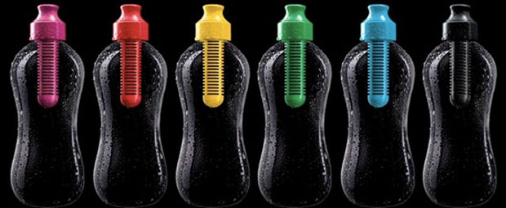

Slide 24
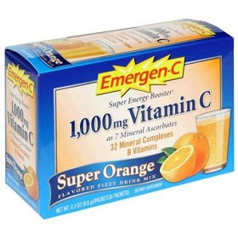

Slide 25
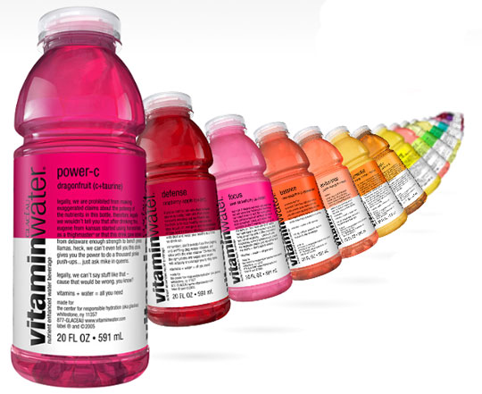

Slide 26
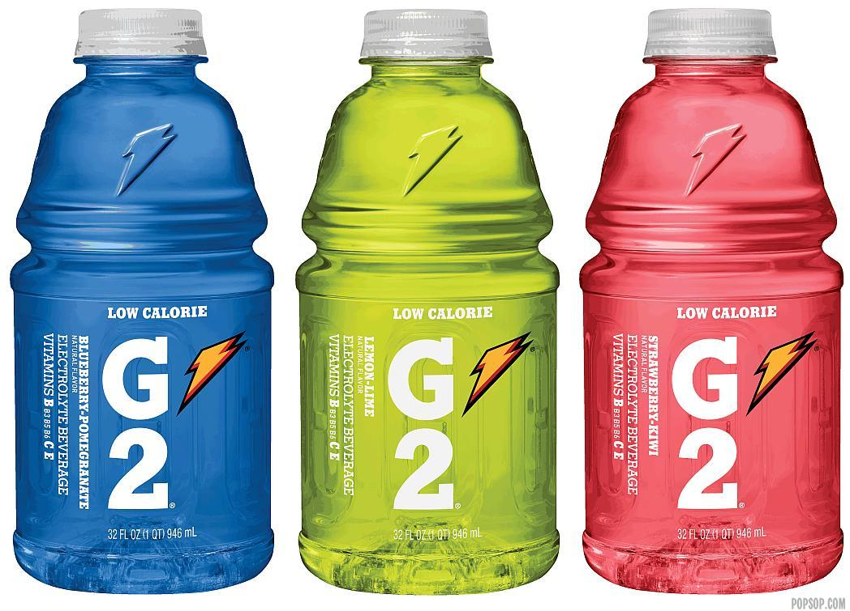
Notes:
Can‘t drink it if you’re not working out, 35g sugar. Non-renewable

Slide 27
Summary
Ayvo bottles filter out impurities
Add supplements you need
Portable- fit in cup holders
RENEWABLE

Slide 28
Healthy Water, Healthy Life

Slide 29
Backup slides

Slide 30
Notes
Add pictures of dirty water
Add pictures
Put gross margin but on a back up slide

Slide 31
http://business.library.wisc.edu/resources/kavajecz/09%20Fall/cocacolavit_pres.pdf

Slide 32
COGS (modify this)
Bottle Part | Quantity per Bottle | Min. Order | Cost Per Order | Cost per Unit | Units Available | Units Required | Units Excess
Body | 1 | 500 | $1,800 | $3.60 | 500 | 500 | 0
Cartridge | 1 | 500 | $1,210 | $2.42 | 500 | 500 | 0
Nozzle (Sport or Casual) | 1 | 500 | $30 | $0.06 | 500 | 500 | 0
Filter Part | Quantity per Filter | Min. Order | Cost Per Order | Cost per Unit | Units Available | Units Required
Aluminum Sieve Mesh #400 | 3.611 sq.in. | 1,805 sq.in | $2.75 | 5.50E-03 | 500 | 500 | 0
Aluminum Sieve Mesh #100 | 3.611 sq. in. | 4,650 sq. in | $12 | $0.01 | 1287 | 500 | 787
Activated Carbon (Charcoal) | 1 | 500 | $500.00 | $1 | 500 | 500 | 0
Plastic Sieve | 1 | 500 | $250 | $0.50 | 500 | 500 | 0
Solid Carbon Block Filter | 1 | 500 | $75 | $0.15 | 500 | 500 | 0
Cartridge | Quantity per Cartridge | Min. Order | Price | Cost per Unit | Units Available | Units Required
Magnesium Hydroxide | 2440 mg | 1.5 kg | $46.25 | $0.08 | 625 | 500 | 125
Magnesium Carbonate | 610 mg | 500g | $19.00 | $0.23 | 819 | 500 | 319
Total Required for Min. Order | Total Cost of Unit | Total Units Available
$3,940 | $8.06 | 500

