Slide 1
By: Sushma Pai, Medha Somisetty, and Nishant Medicharla
Notes:
Introduce yourselves..Give a tile for your self if you wish to ..

Slide 2
The Problem
Obsessive Compulsive Disorder, or known as OCD, is a disorder of the brain and behavior. They are thoughts that appear over and over again, and are just things you want to get out of your head, but you can’t . In America alone, OCD has been affecting 3 million people and is continuing to grow. It is as prevalent as cancer.
Examples:
Checking the door to see if it’s locked constantly.
Making sure everything is clean.
Constantly organizing everything.
Obsession distracts everyday life without even realizing sometimes.

Slide 3
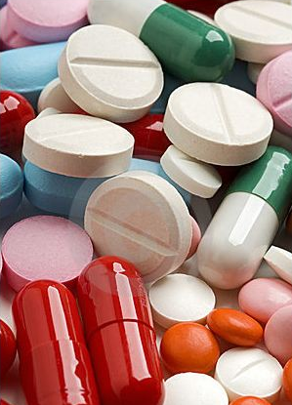
How is OCD currently being treated today
The most common way to treat OCD today is one-on-one psychotherapy in which patients are forced to face the “object of terror” (their one main obsession). Experimental drugs are also frequently used in order to temporarily suppress OCD impulses, but these drugs are not long lasting and have caused disastrous side effects such as schizophrenia. For one-third of the people who use these types of medications, it usually fails.
Notes:
How is OCD currently being treated . Put some content about that. http://psychcentral.com/lib/treatments-for-obsessive-compulsive-disorder

Slide 4
Our Mission
Currently, there is no cure for OCD, and the treatments that are commonly used are ineffective and expensive. Our goal is to attempt to decrease the OCD urge . What do you think we created? Snapit! Snapit is a specially designed bracelet to suppress OCD symptoms. We plan to develop our solution in two phases.
Phase 1
Phase 2
Product Name : SnapIT
Trying to raise awareness for OCD
We will make silicon bracelets that you can snap by yourself, so you can get distracted from doing the OCD actions.
Product Name : Intelligent SnapIT
We will make an intelligent bracelet that can detect OCD symptoms.
It will send signals to the nearest phone through bluetooth and then the phone will tell the wristband to start tightening, vibrating or to play music to distract that person
Notes:
Our solution is two fold 1) Short term 2) Long Term .. Describe both plans Content for Short Term :http://www.calmclinic.com/anxiety/treatment/wrist-band

Slide 5
Phase 1
Product Name : SnapIT bracelet
Phase 1 is where we will try to bring awareness about OCD. We will make special silicone bracelets, and sell them to fund our research. People will know about our product through social media, our website, and through mental health organizations. We plan to raise about $2M in 2 years through our SNAP-IT Bands.
http://medhasomisetty.wix.com/snapit
Notes:
Desscrive Short term http://www.calmclinic.com/anxiety/treatment/wrist-band

Slide 6
Phase 2
Product Name : Intelligent SnapIT bracelet
Solution: Bracelet detects OCD symptoms, Transfers signals to a computer via Bluetooth . Computer then processes the signals and sends signal back to the bracelet to vibrate, tighten up or play music. This action will distract the person and suppress their OCD symptoms.
comes in. This bracelet can detect OCD signals. When this bracelet detects the OCD signals, the bracelet will either tighten up, vibrate, or play music. You can choose which ever way you want it. This will distract you from doing your OCD actions. Every time you do an OCD action it will keep distracting you until you just walk away and stop it.
Notes:
Describe long term plan

Slide 7
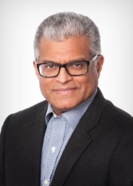
Our Interview with a Neurologist and Psychiatrist
We talked to a Neurologist and a Psychiatrist to see if our idea was possible. YES it is!
Neurologist Dr.Rajiv Joseph
Psychiatrist
Dr. Rekha Pole
Neurologist Rajiv Joseph said we have to track an EEG signal from the brain which stands for electroencephalogram.
Physiatrist Rekha Pole said that OCD was a disfunction in the part of the brain called the Basal Ganglia and we will have to look out for Neurotransmitters.
Notes:
our research on long term solution

Slide 8
Market Opportunity
Direct
Indirect
We will first sell our Intelligent SnapIT bracelets to people with OCD and try to get our market share and customer confidence.
Once we sell directly , we will try to license our patented technology to other wristband manufacturers like Nike Fuel Band, Fitbit, and Jawbone.
Notes:
Market opportunity .. integrate to Nike Fuel meter, fit bit and Jaw bone types of Wrist bands.

Slide 9
Competition
Our bracelet is a one of a kind bracelet. There is no other bracelet in the market, that can detect OCD. Our company is the only company that has unique and innovative wristband that detects and suppresses OCD- related impulses.
We have a huge potential for our product.

Slide 10
Marketing
Phase 1- We will bring awareness for our silicon bracelets by advertising them on major medical websites like www.webMD.com, www.healthcentral.com, and www.wrongdiagnosis.com. Also we will create our own website. We will also distribute at major hospitals. Also at Mental Health Organizations. We will also begin developing contacts with Fitbit, Jawbone, and Nike.
Phase 2- Once we have the Intelligent SnapIT bracelet, we will reach out to all our contacts to whom we sold the bracelets in phase-1. We will also sell these from our website, on Ebay and Amazon, and advertise on major medical websites and magazines like the ones listed above.
Notes:
How will you bring awareness a

Slide 11
Our Sales
Phase 1
Phase 2
Year -1
Sales: $1.02M
Units: 102K
Cost per unit: $10
Cost to make: $2
Year-3
Sales: $2.5M
Units: 10,350
Cost per unit: $249
Cost to make: $100
Year-4
Sales: $26.6M
Units: 102k
Cost per unit: $249
Cost to make: $100
Year- 2
Sales: $1.1M
Units: 114k
Cost per unit: $10
Cost to make: $2
Year-5
Sales: $ 63.95M
Units:246k
Cost per unit: $249
Cost to make: $100
Notes:
how will you raise money to find a solution to the problem .. sells bands and raise money .. how much do you plan to raise 1 Mil

Slide 12
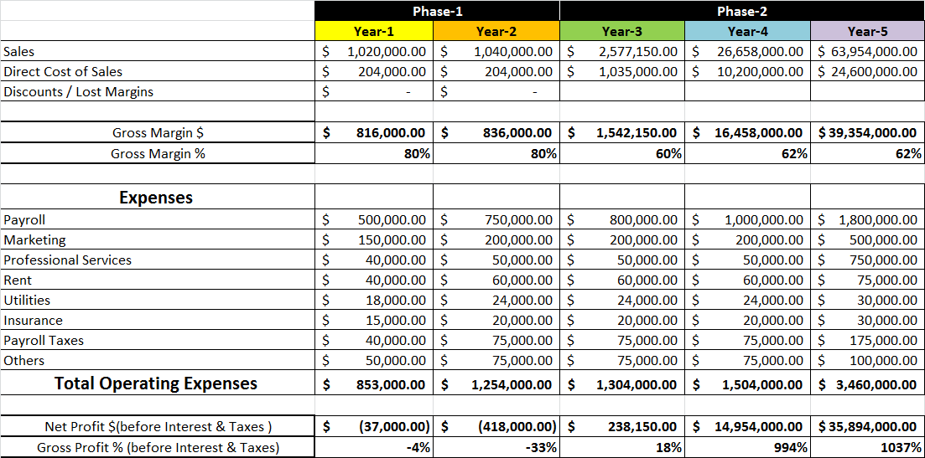
Financials

Slide 13
Exit Summary
After 5 years with a significant growth we will plan to cash out . We will try to sell our company to:
Pharmaceutical Companies
Wristband Manufacturers
Healthcare Related Companies

Slide 14
Questions?
THA

