Slide 1
AllerStat
Naina Rao, Kavi Shah, Aakash Pai,
Simar Bhalla, Parakh Jaggi
November 4, 2012
Type of Company: C Corporation
Date of Incorporation: September 26th, 2012
State of Incorporation: Texas

Slide 2
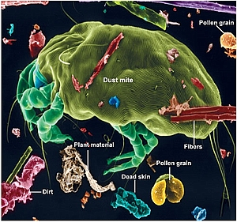
Problem
Allergies are a widespread problem
Fifth leading chronic disease for adults and 3rd for children

Slide 3
Solution
Our device will be identifying the allergens in the air
Inflammation will be reduced significantly as a result of this detection
The device would provide victims simple solution to a deleterious problem

Slide 4
Business Value
There is no product out on the market that actually indentifies allergens in a room
Only preventative products that fix the problem after the damage is done
We offer a device to solve this issue that allows consumers to specify the allergens in their environments and solve the problem

Slide 5
Competition and Barriers to Entry
Honeywell-
At present, Honeywell, in addition to other popular A/C companies, have devices on the market that purify air through filtration.
However:
These devices are expensive and only act as preventative measures.
Not only will our product be inexpensive, but it will have better mobility and be a more convenient option.

Slide 6
Technology
Our current product is designed to be a semi-permanent fixture that hooks on to room walls and tracks allergen levels in the room.
We have made the product USB friendly
The user can plug in the sensor into their electronic device for the results or view on touch screen

Slide 7
Personal with screen (Device #1)
This product will include a touch screen through which individuals can immediately access the allergens present in the air and effect methods of removing the allergens.
This will require no alternate connection with another device

Slide 8
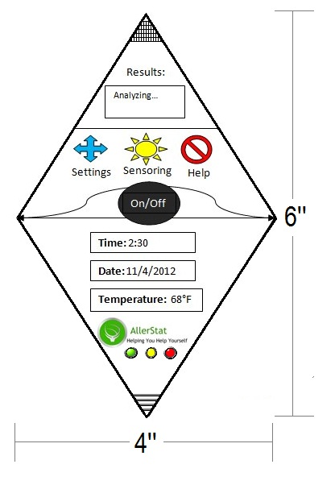
Product

Slide 9
Product Evolution
Our 2nd and 3rd product are in the research stage of development
The 2nd product is not going to include the touch screen and will be cheaper
The 3rd product includes a central control unit that displays the statuses of multiple AllerStats placed throughout the building.

Slide 10
Operational Plan
We are raising $2m in Series A capital, no additional capital anticipated for positive cash flow
First revenue in June 2013
The company will be profitable by end of 2013
Detailed operational plan available

Slide 11
Total Available Market and Sales Addressable Market
Enormous market potential
Unfair advantage due to our relationships in Hotel industry
Worldwide potential

Slide 12
Head Count
Lean operation until cash flow positive
Growth will only be based on results

Slide 13
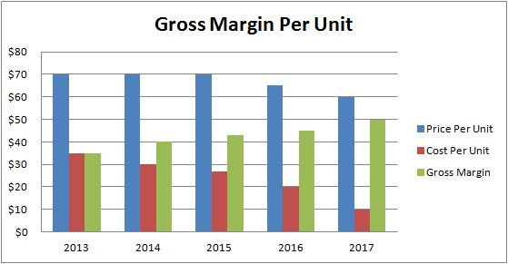
Revenue and GM
Healthy gross margins because of cost structure and price the market can bear
Projections are a fraction of sales addressable market

Slide 14
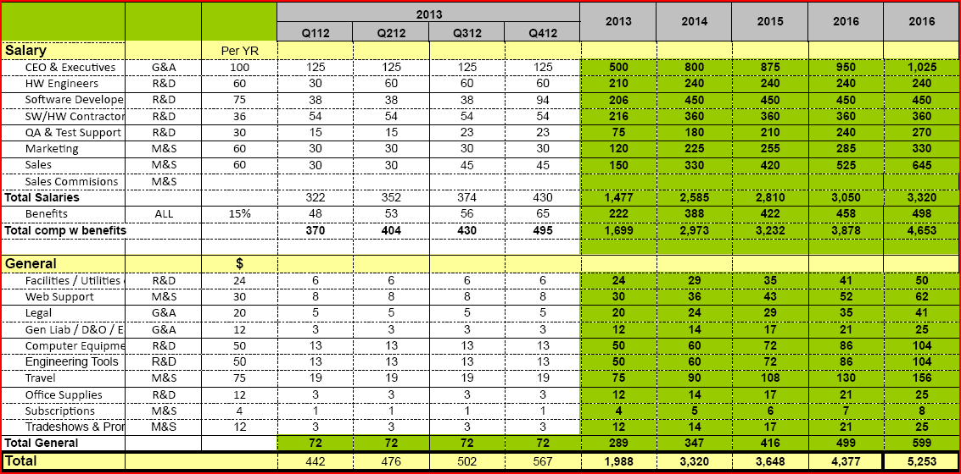
Expenses

Slide 15
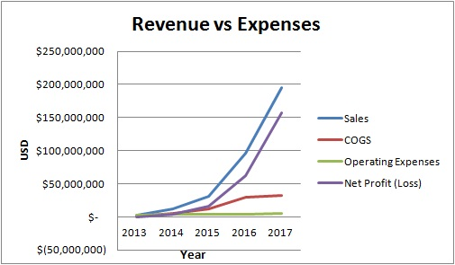
Profit and Loss
Company profitable by 3rd Q 2013
Excellent Rate of Return to the
investors

Slide 16
Exit Strategy
We plan on an initial public offering
Market share will reach about 20%
Estimated to occur in year 4 or 5

Slide 17
Management and Advisory Board
Management
Naina Rao- CEO
Parakh Jaggi- COO
Kavi Shah- CTO
Aakash Pai- VP of Marketing and Sales
Simar Bhalla- VP of Engineering
Advisory Board
The advisory board consists of
Pawan Jaggi, Founder, Chairman at www.goambition.com
Ram Viswanathan, President & CEO, Nathan Research, Inc.
Lynne Doughtery, Senior VP, Owner & Franchise Services, Starwood Hotels
Christopher J. Nassetta, Presient and CEO of Hilton Worldwide

Slide 18
Questions?

